Slide 1
E - Business Data
For the future of our business . . . . .
Amita Akole Yongnian Cao Vishal Goyal Shivam Khare Sunil Kumar Sushil Satya

Slide 2
Project Overview:
Introduction & Goals
Dataset Overview & Simulation
Data Cleansing & ETL Process
Outcomes of Visualization
Result Comparison
Models of Analysis
Closing & Limitations
Future Application
Notes:
Post notes here - for guidance on what to speak on.

Slide 3
Introduction:
In this project we will be focusing on:
Analysing the previous sale’s record to know what items customers purchased previously
Provide other businesses with knowledgeable insights from Amazon sales to see a remarkable growth in company’s sales and to increase company’s profit using Statistical Analysis, Predictive Analysis and FP-Growth Algorithm.

Slide 4
Goal:
Successfully provide other businesses with knowledgeable insights from Amazon sales
to see a growth in company’s sales and increase profit.
Deeper analysis used to recommend additional products that other customers purchased when buying those same items. Based on:
Popularity
Season or Occasion,
Goal is to guide preferences for online shopping so that we can advertise more during that phase.

Slide 5
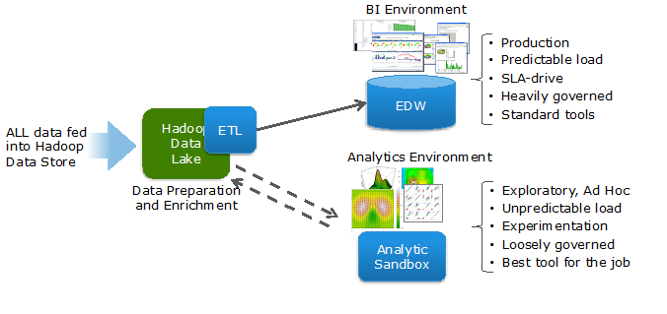
Preparing the Analytical Data Set:
Advantages of an Analytics Sandbox
Perhaps most significant is that it decreases the amount of time that it takes a business to gain knowledge and insight from their data.

Slide 6
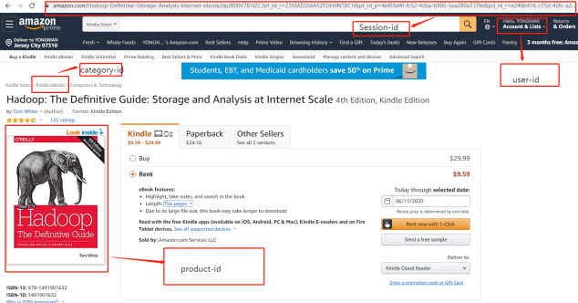
Preparing the Analytical Data Set
How did you get the data
Actually, this data set came from PC and mobile app. Our company’s webserver capture every customer’s visiting, order and payment behaviour and store into Nginx.

Slide 7
Preparing the Analytical Data Set
2. What did you put the data into?
We need to load our data-set before we start working on ETL part. We get the direction where our data-set store in and load into Spark

Slide 8
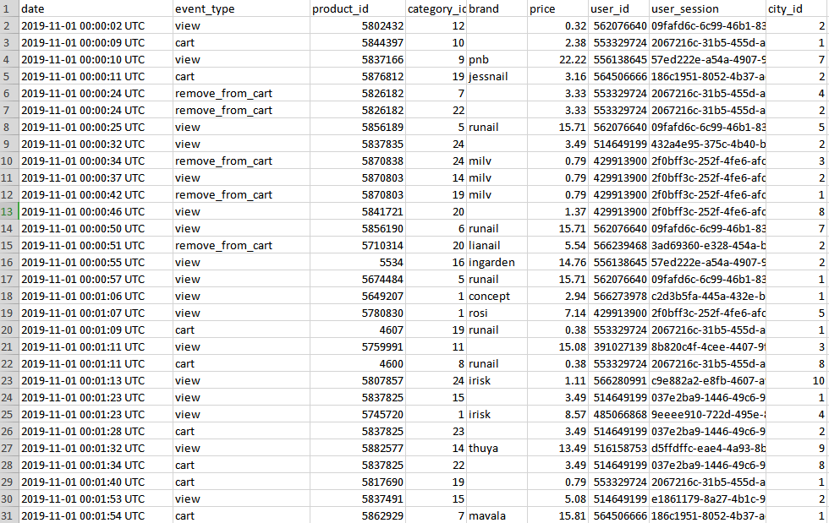
Building the Dataset:
There are 8 columns in our E-Business dataset namely Event_time, Event_type, Product_Id, Category_Id, Brand,Price, User_Id, Session_Id, and City_Id.

Slide 9
Simulation:
Product count result hypothesis: We assume customers prefer to buy some daily necessaries, books, and clothes.
City count result hypothesis: We assume some higher population cities present a higher sales count like in New York City, California.
Time count result hypothesis: We assume customers would like to visit our website after working time or before bedtime.

Slide 10
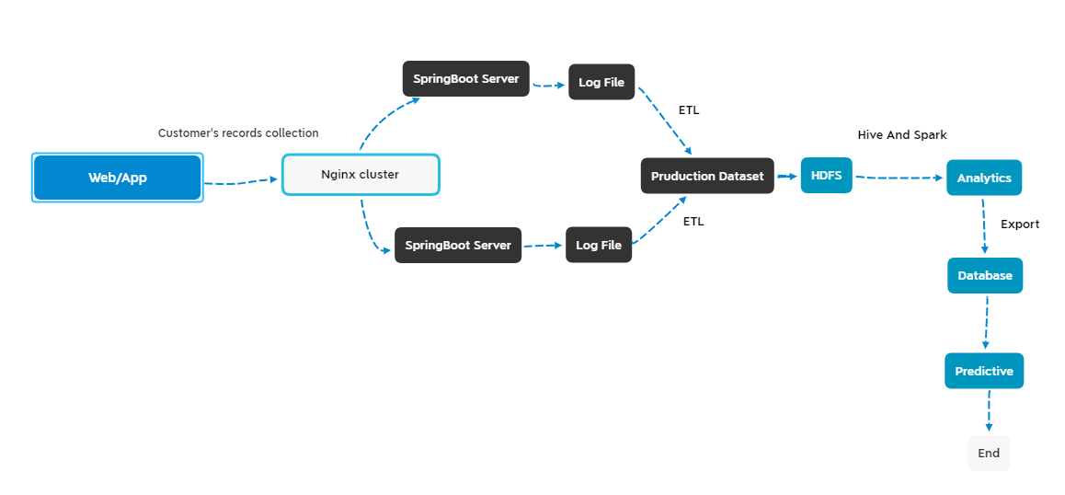
Data Process Representation:

Slide 11
ETL Section:
ETL is a type of data integration that refers to the three steps (extract, transform, and load) used to blend data from multiple sources.
In this process data is extracted from a source system, transformed into a format that can be analyzed, and loaded into a data warehouse or other system.
ETL can improve data professionals’ productivity because it codifies and reuses processes that move data without requiring technical skills to write code or scripts.

Slide 12
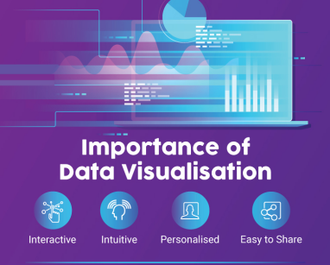
Importance of visualization
Data visualization is the representation of data of information in a graph, chart or others. It communicates relationships of the data with image. This is important because it allows trend and pattern to be more easily seen.
Data visualization makes result easier to identify the trends than looking through thousands of rows on a spreadsheet. It’s the way the human brain works.

Slide 13
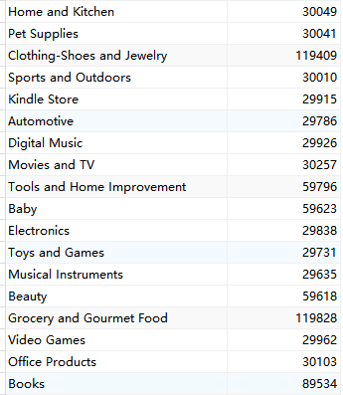
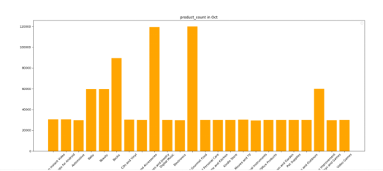
Data manipulation:
1. Product count:
This shows the count of products sold from each department like Electronics or Books or Video Games etc. Firstly, we need to pick the 'product' column and set by (product,1) the “key-value-Tuple”. And the next step would be to aggregate them together.

Slide 14
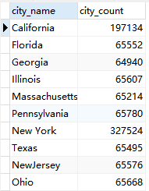
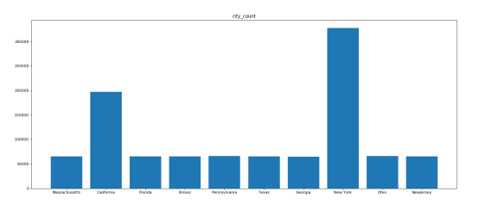
Result Comparison between Production Data Set & Analytical Data Set:
2. City count result:
This shows the count of products sold in each city. We want to find some popular cities. This result helps the advertisement department colleagues to calculate every city's budget and convert their ROI.

Slide 15
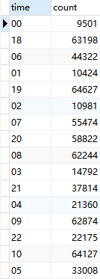
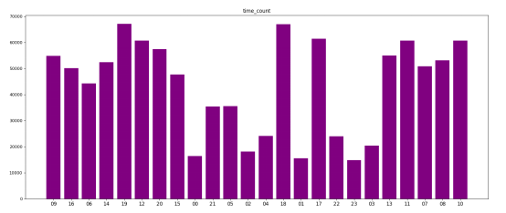
Result Comparison between Production Data Set & Analytical Data Set:
3. Time count result:
This shows the time and count of products sold. This result helps the advertisement department colleagues to analyze the time at which customers are more active.

Slide 16
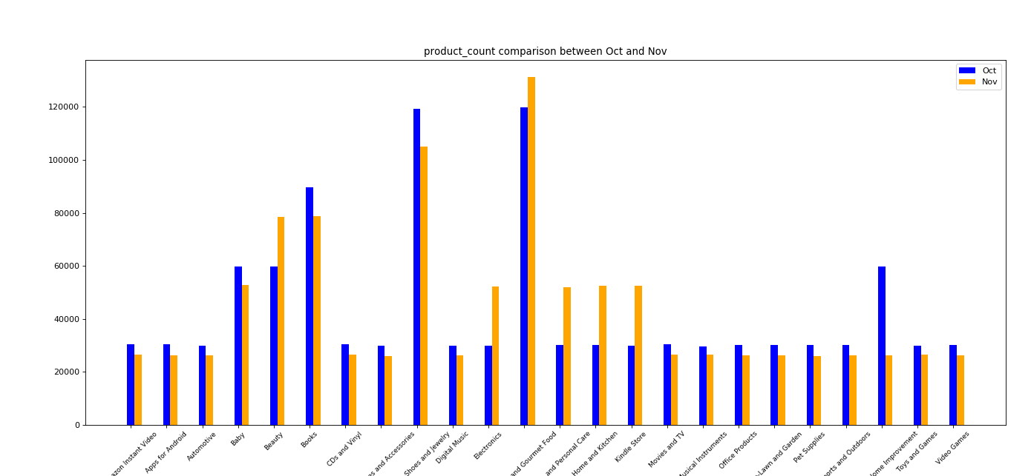
Hypothesis proof:
1. Product count hypothesis result:
Based on the last picture, we see the books, Clothes and food are the main source during October and November. Beauty and clothes products are also popular in the market. We should provide this result to the product departments.

Slide 17
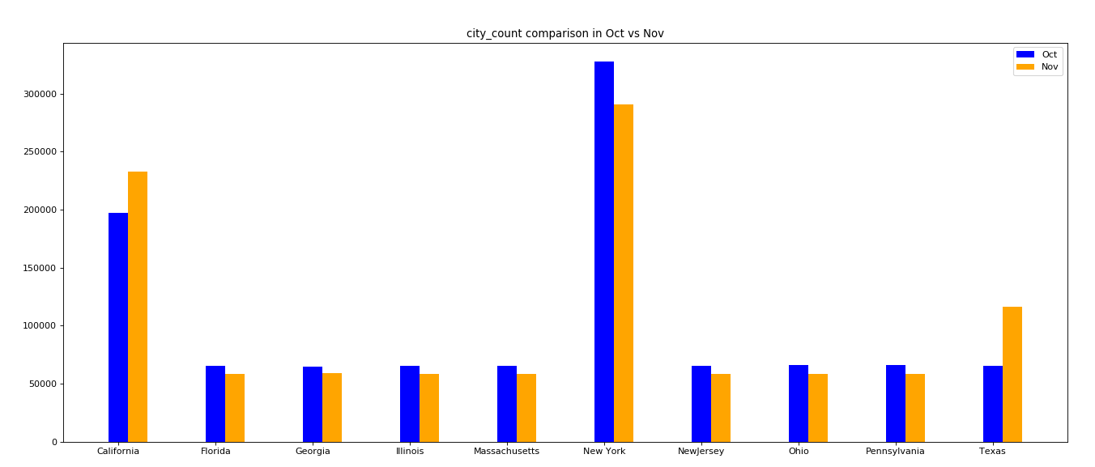
Hypothesis proof(contd.):
2. City count hypothesis result:
Based on the comparison between Oct and Nov. Our assumption about some big cities might have higher sales than others are correct. New York City and California present a higher customer’s number.

Slide 18
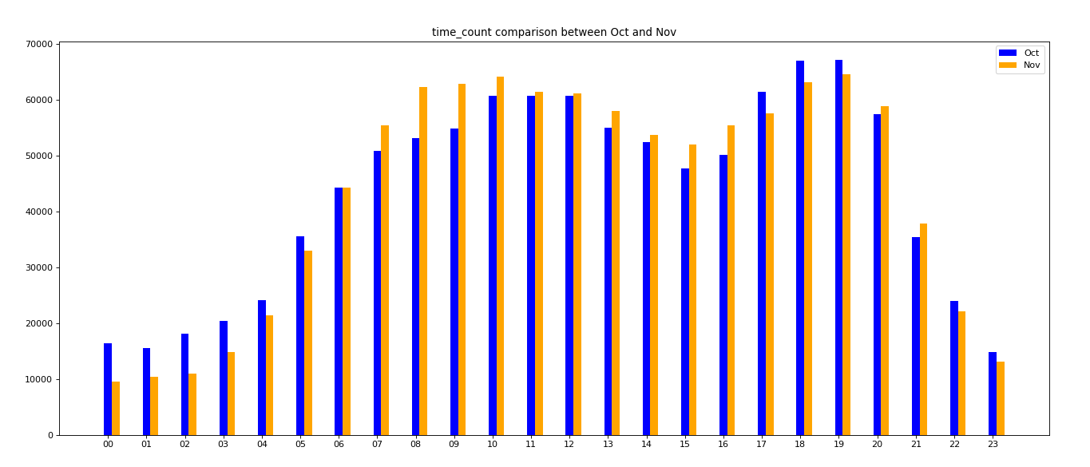
Hypothesis proof(contd.):
3. Time count hypothesis result:
We guess customers would like to visit our website during the evening period than at night. It seems our hypothesis is right. We need to allocate our advertisement in the evening time to improve the ROI.

Slide 19
Models of Analysis:
For our project, we have used models for analysis:
Predictive Analysis
FP-Growth Algorithm

Slide 20
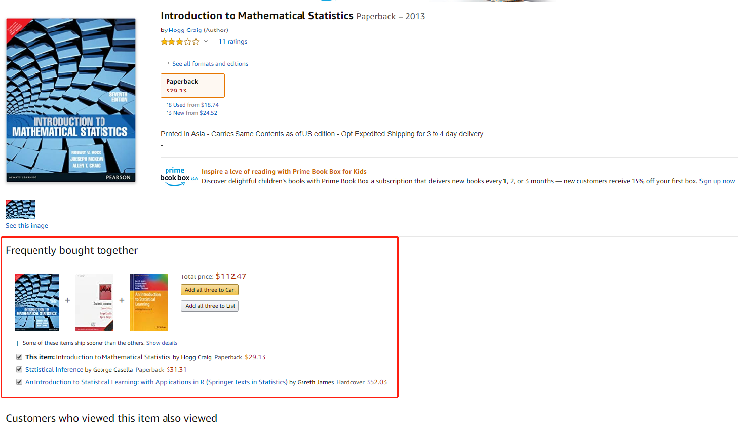
Predictive Analysis
When we taking online-shopping like in Amazon. The website always recommend some other related product with it. Why these product refer to us? How to implement this feature?
Notes:
For our project, we use Predictive Analytics to analyze the previous sales record to know what items customers purchased previously, what is in their online shopping cart or on their wish list, which products they reviewed and rated, and what items they search for most. These analytics help us to figure out every customer’s behaviour. These analyses help us to make decisions to increase the company’s profit.
Predictive Analysis helps us with a deeper understanding of customer habits and preferences. Predictive search capabilities have been built-in to an analytics solution that allows us to analyze customer's past click-through behaviours, shopping history, and product preferences, in real-time.
We will be implementing Predictive Analysis for the same purpose as it allows continuous analysis of customer data and will provide the most relevant results and recommendations to users.

Slide 21
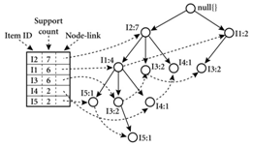
FP-Growth Algorithm
The FP-Growth algorithm is used to find the connection between products and customers as it provides efficient implementation of frequent pattern mining.
The mining data is decomposed into sub-datasets according to the frequent patterns identified which leads to the more focused search of smaller databases.
Notes:
In our project, we will use the FP-Growth algorithm to find the connection between products and customers as it has proved to be the most advanced and efficient implementation of frequent pattern mining.
The FP-Growth Algorithm is an alternative way to find frequent products without using candidate generations, thus improving performance. For so much, it uses a divide-and-conquer strategy. The core of this method is the usage of a special data structure named frequent-pattern tree, which retains the item-set association information.
The mining data is decomposed into sub-datasets according to the frequent patterns identified which leads to the more focused search of smaller databases.
Due to the divide and conquer strategy, FP-Growth Algorithm is the most efficient method for data mining. Additionally, there are no repeated scans of the whole database.

Slide 22
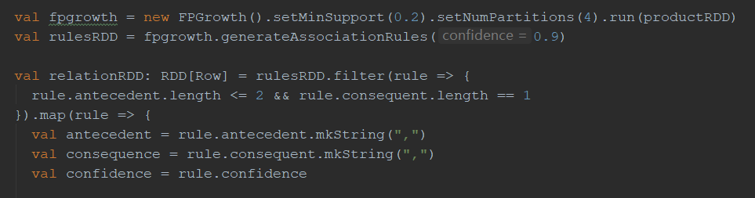
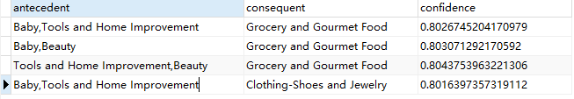
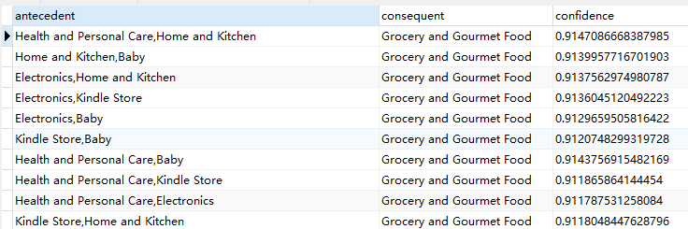
Product relations comparison:
Product relations in October Product relations in November

Slide 23
Closing:
It’s clear that baby and beauty product presents a stronger relation with grocery things in October records. Thus, we can display some beauty and baby products when customers search for baby products. And health products connect with the grocery foods in November records. As the same, we need to show more health related products when people visit grocery departments.

Slide 24
Future Application:
Recommendation System and Understand the customer behaviour:
i. Recommendation systems can be a very powerful tool in a company’s arsenal. Some of the applications include being able to anticipate seasonal purchases based on recommendations, determine important purchases, and give better recommendations to customers which can increase retention and brand loyalty.
ii. Customer’s behaviour is essential for company to find the success for its current product situation as well as new product launches. Understanding every customer’s attitude and favor become a key role in the market.

Slide 25
Limitations:
Missing Values : There are some missing values in the data set and we cannot take a few data to make some prediction.
Spreaded Dataset: The city name and category name in the other document. We need to take lots of “join sentence” in SQL. It takes more time and has adverse effects on code efficiency.
Gender Data Missing: The data set doesn’t show the user’s gender. It causes a little inconvenience in some analysis that we will be performing.

Slide 26
Thank You From Group 4!!
Discussion
Amita Akole Yongnian Cao Vishal Goyal Shivam Khare Sunil Kumar Sushil Satya

